Slide 1
Real Estate Market Analysis Dashboard.
Presented by
Vinayak Swami
Instructor Name: Mr. Ashutosh Hiskiel
06-04-2024

Slide 2
Objectives
Identify Market Trends: Analyze historical data to identify trends in property prices and rental rates over time.
Understand Property Prices: Examine factors influencing property prices, including location, size, and market demand.
Evaluate Rental Rates: Assess rental rates across different property types and locations to understand market demand and potential rental income.

Slide 3
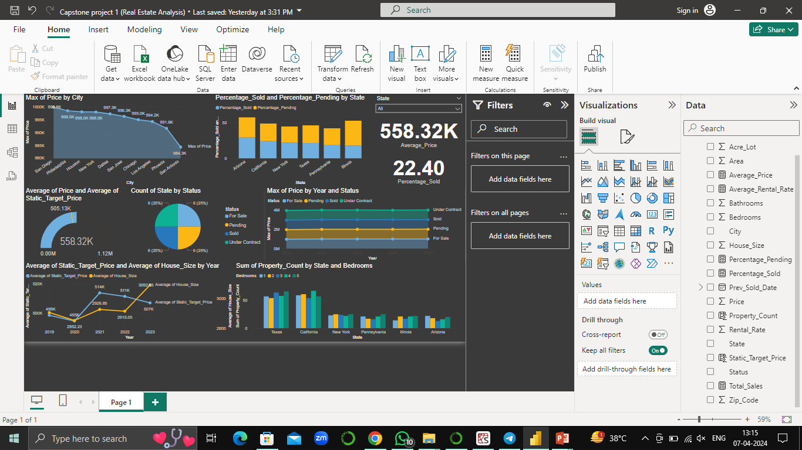

Slide 4
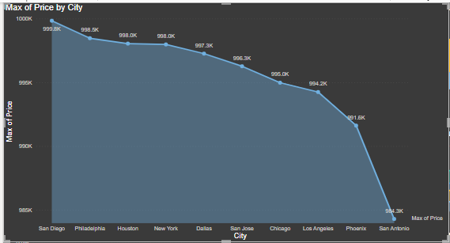
Area Chart: Property Price Trends
Total Sales trended up by 2.19% between 2019 and 2023.
San Diego had the highest maximum price at $999,837, while San Antonio had the lowest maximum price at $984,291.
Price range across all 10 cities ranged from $984,291 to $999,837.
Percentage Pending diverged the most from Percentage Sold in Illinois.
Properties under contract accounted for 27.00% of the total count.
The most recent price anomaly occurred in 2020, reaching a high of $35,241,359.
Category 5 had the highest total count, while Category 3 had the lowest.

Slide 5
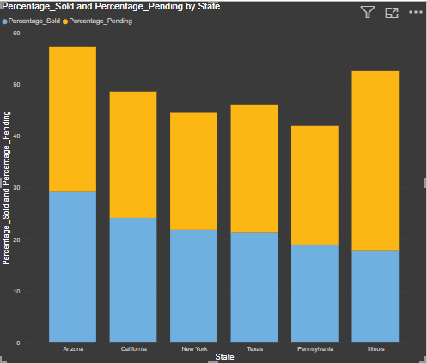
Stacked Column Chart: Property Sales Status by State
Total property sales trended up, resulting in a 2.19% increase between 2019 and 2023.
Percentage pending and percentage sold diverged the most in Illinois, with percentage pending being 16.84% higher than percentage sold.

Slide 6
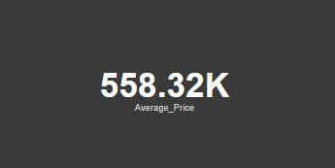
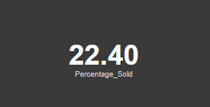
Key Metrics: Average Price and Percentage Sold
The average price of properties in the dataset is $558.32K.
The percentage of properties sold out of total properties listed is 22.4%.
Analyzing these key metrics provides valuable insights into the real estate market dynamics.

Slide 7
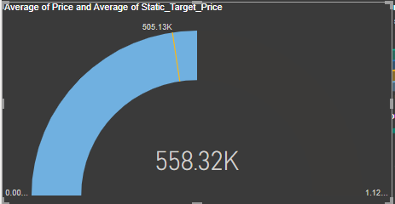
Gauge Chart: Average Price vs. Target
The average price of properties trended up over the specified period, indicating Positive growth trend observed in property sales, with a 2.19% increase from 2019 to 2023.
Visualizing the average price compared to the static target price using the gauge chart shows $558.32K average price meets its match against a $505.13K static target, revealing the pulse of performance.

Slide 8
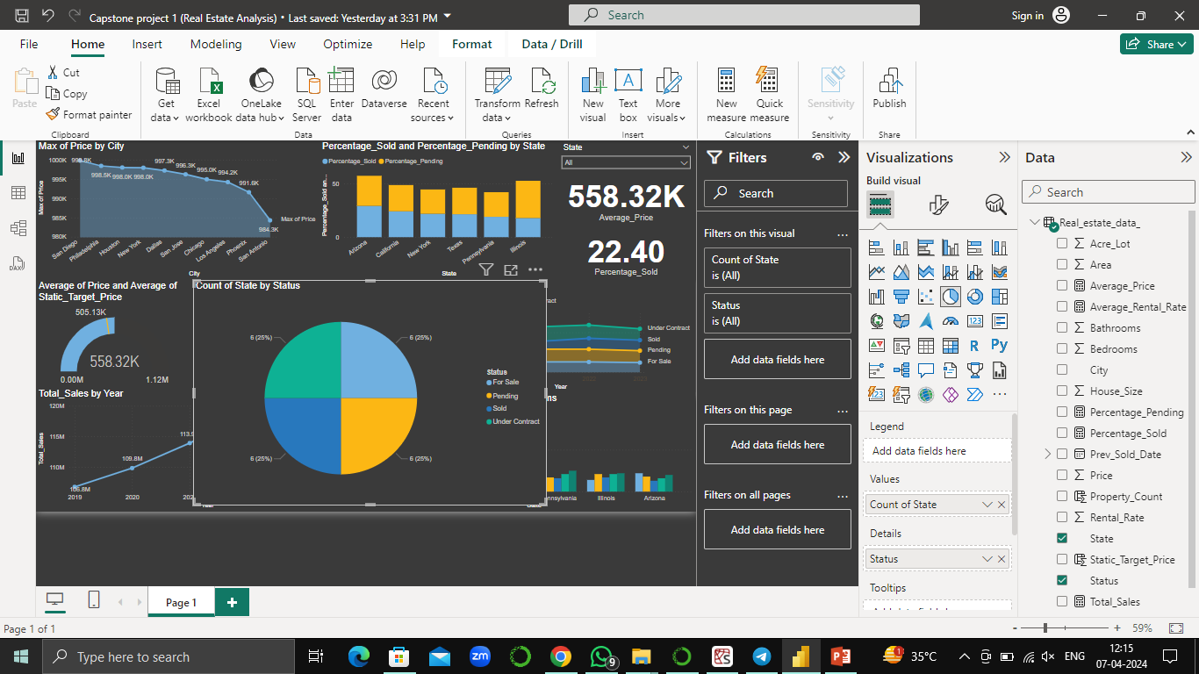
Pie Chart: Distribution of Property Status by State
Total Sales trended up, resulting in a 2.19% increase between 2019 and 2023.
Total Sales started trending up in 2019, rising by 2.19% (2,334,480 units) in 4 years.

Slide 9
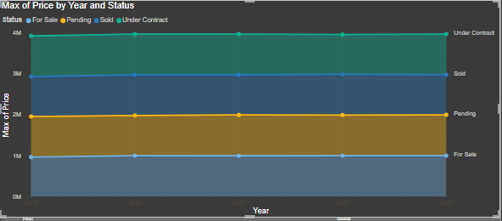
Stacked Area Chart: Trend of Property Prices Over Time by Status
Visualize the trend of property prices over time by status using a stacked area chart.
Total Sales trended up, resulting in a 2.19% increase between 2019 and 2023.
Total Sales started trending up in 2019, rising by 2.19% (2,334,480 units) in 4 years.

Slide 10
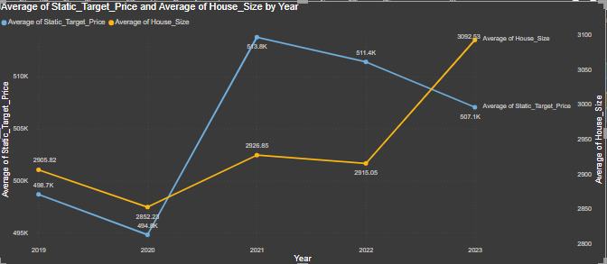
Line Chart: Comparison of Average Static Target Price and Average House Size Over Time
Visualize the trend of the average static target price and average house size over time using a line chart.
Average of Static Target Price (1.67% increase) and Average of House Size (6.43% increase) both trended up between 2019 and 2023.
Average of House Size started trending up in 2019, rising by 6.43% (186.72 units) in 4 years.

Slide 11
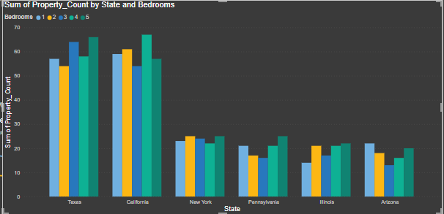
Clustered Column Chart: Property Count by State and Bedrooms
Display the distribution of property count across different states, segmented by the number of bedrooms, using a clustered column chart.
Average of Static Target Price (1.67% increase) and Average of House Size (6.43% increase) both trended up between 2019 and 2023.
Average of House Size started trending up in 2019, rising by 6.43% (186.72 units) in 4 years.

Slide 12
DAX Functions Explanation
Average_Price: Calculates the average price of properties listed in the Real_estate_data table
Average_Rental_Rate: Computes the average rental rate of properties listed in the Real_estate_data table.
Percentage_Pending: Calculates the percentage of properties in the "Pending" status out of the total properties listed.
Percentage_Sold: Computes the percentage of properties in the "Sold" status out of the total properties listed.
Static_Target_Price: Sets a static target price based on the state. For example, in New York, the target price is $500,000.
Total_Sales: Calculates the total sales value by summing up the prices of all properties listed.
Property_Count: Represents a count of properties. This function is constant and doesn't vary based on data.

Slide 13
Conclusion
In conclusion, our exploration of the real estate market through various charts, DAX functions, and discussions has provided significant insights into market trends, pricing dynamics, and property sales. By analyzing data on average prices, rental rates, percentage pending, and percentage sold across different states, we've gained a comprehensive understanding of market conditions. Additionally, the comparison of actual sales with static target prices offers valuable insights into performance against predetermined goals. Overall, this analysis equips stakeholders with the knowledge needed to make informed decisions, adapt to market changes, and capitalize on opportunities within the real estate sector.

Slide 14


